Slide 1
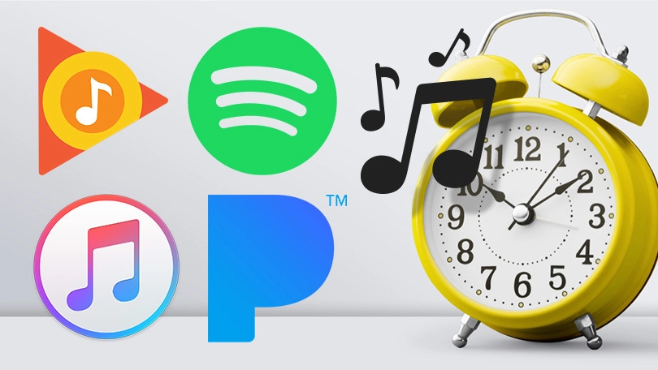
CHRONO
BEATZ
By Johnny Mahone
Replace your devices boring alarm sounds with your favorite music!

Slide 2
CHRONO
BEATZ
What was the idea?
I wanted to create an digital alarm clock application that plays the user’s .mp3 files as the alarm sound.
What source code/tutorials did you find?
I found a basic alarm clock to use as my template here https://medium.com/dev-genius/how-to-make-a-clock-with-python-7587e107bb5e and there is also a github https://github.com/DivyanshAgrawal2009/Clock
How did my project develop?
I started with getting the code to execute properly. Then I focused on the cosmetics of the GUI.
I was surprised by how easy Tkinter was to learn after some research and trial and error. The scope of my project never really changed, I just had to problem solve issues that came about.

Slide 3
CHRONO
BEATZ
I overcame the following roadblocks:
Lack of experience using Tkinter – Conducted online research
Needed a way to play mp3 files – started with playsound module but that was too basic, then I found out Pygame has a music player “Pygame mixer”
Lack of experience using Pygame mixer – was only able to play mp3 that I coded into the program so had to research a way for user to add mp3 files to the application and then have Pygame mixer play those files.
Discovered Tkinter Listbox widget and filedialog module – researching these two features allowed me to solve my problem.
When the alarm executed the application would not be accessible until the entire mp3 file played to completion
I added a function and button to silence the alarm
Once the alarm was set or silenced the application allowed no further input, it needed to be closed and reopen to set another alarm
I added a function and button to reset the alarm
Moving forward I would continue to improve the cosmetics of the GUI.

Slide 4
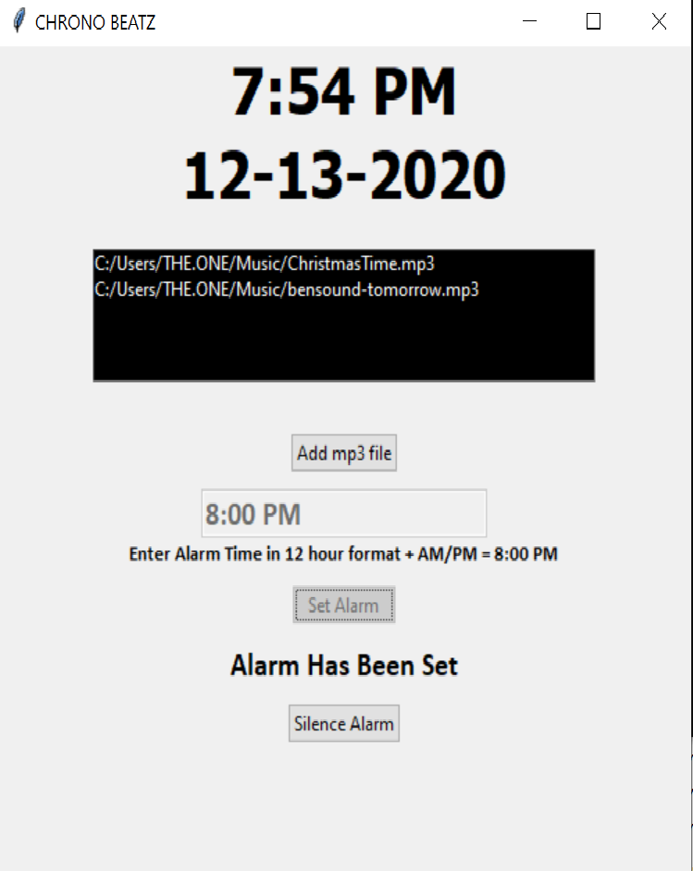
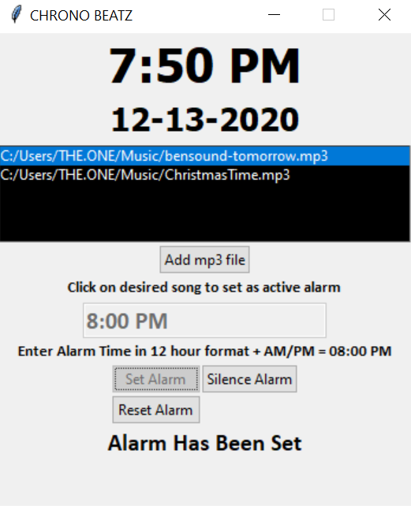
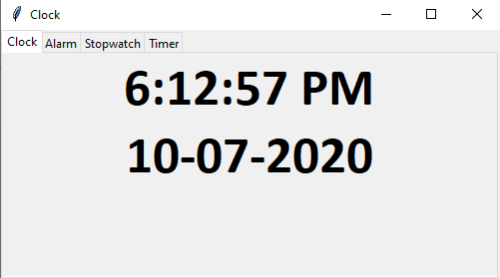
CHRONO
BEATZ
Pack method
Grid method
Original design template

